Slide 1

“You cannot manage what you cannot measure”
Peter F. Drucker
(1908 – 2005)

Slide 2
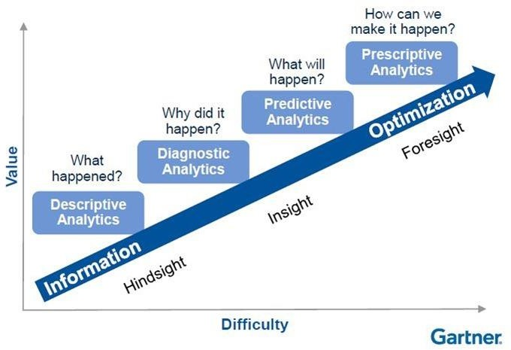

Slide 3
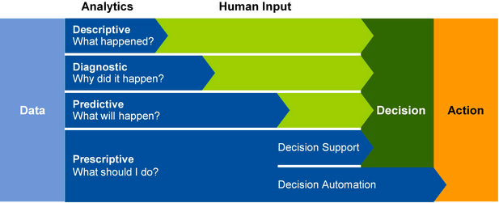

Slide 4
“The essence of becoming data-driven is making better decisions up and down the organization”
WHY
You have to gather, store, and exploit data full of facts containing
both insights and lessons learned to progress your company.
Empowering people with easy data access will dramatically improve time to decision making and predictable business outcomes. It will create new opportunities and reduce cost of operations, increasing top and bottom line. In tomorrow’s world it is all about knowing where to go.

Slide 5
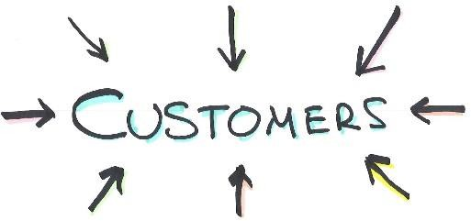



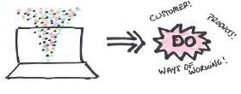

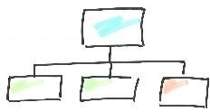
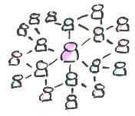








The Focus
Using Data science and AI to Drive
WHAT
Requires data and access to it as Fuel
Needs Connecting data,
people and organizations
On a
HUGE scale

Slide 6
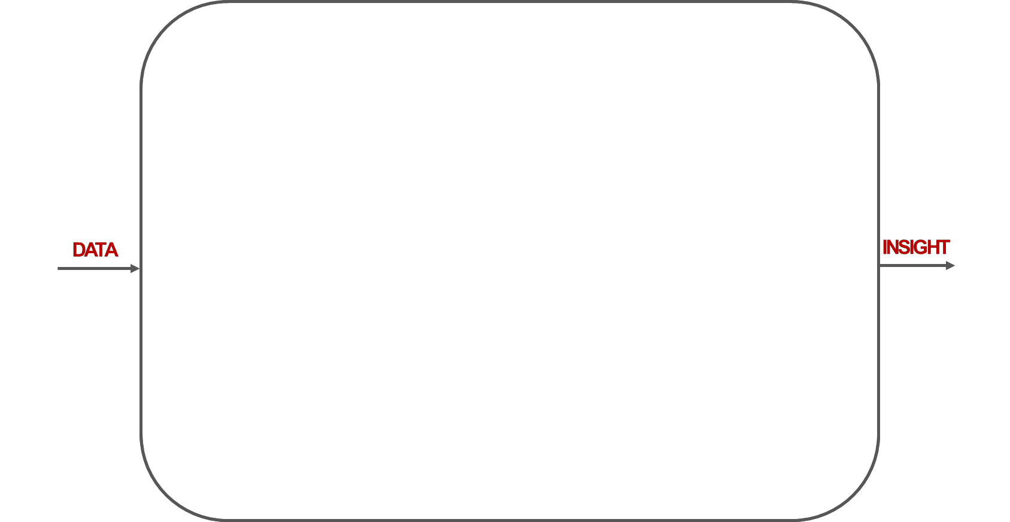
Source

Slide 7
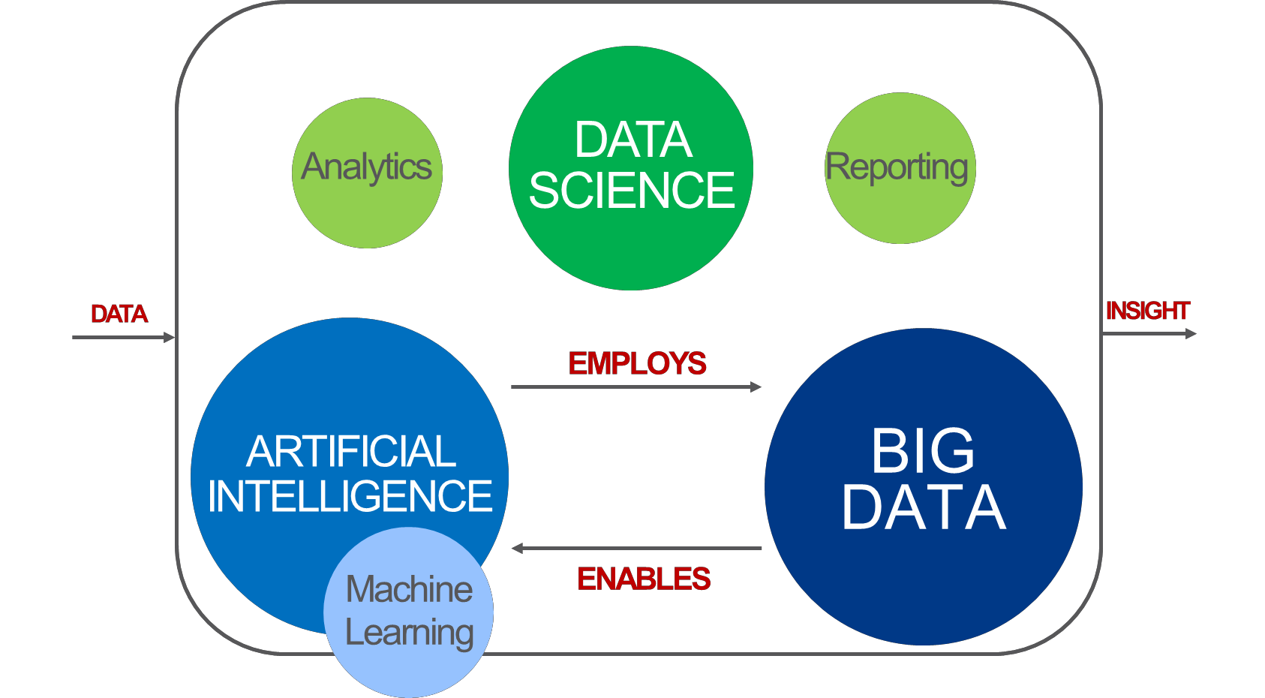
Source

Slide 8
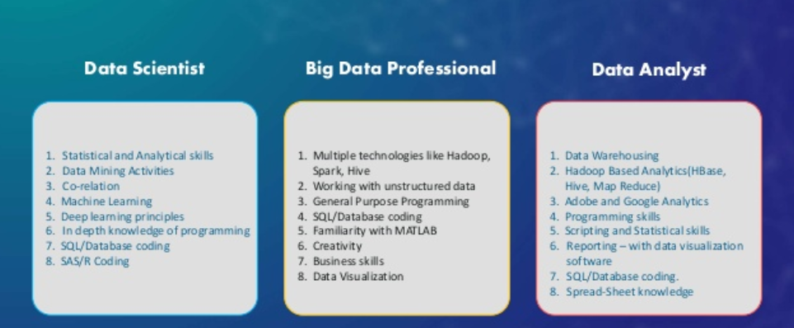

Slide 9
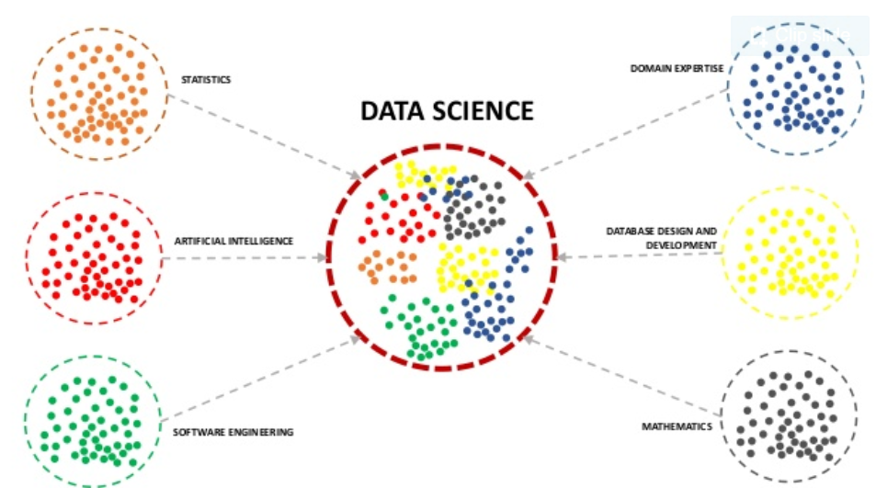

Slide 10
Generating value through data
Acquisition, Compiling, cleaning, structuring data
Processing data through Artificial Intelligence, Machine Learning, Reporting, Predictive analytics and more
Generate insights and realize tangible business value – increased revenue, cost reductions, etc.

Slide 11
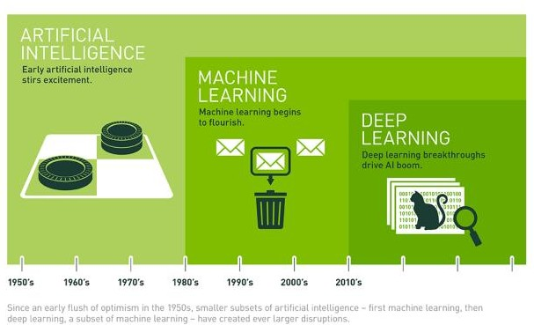
Source

Slide 12
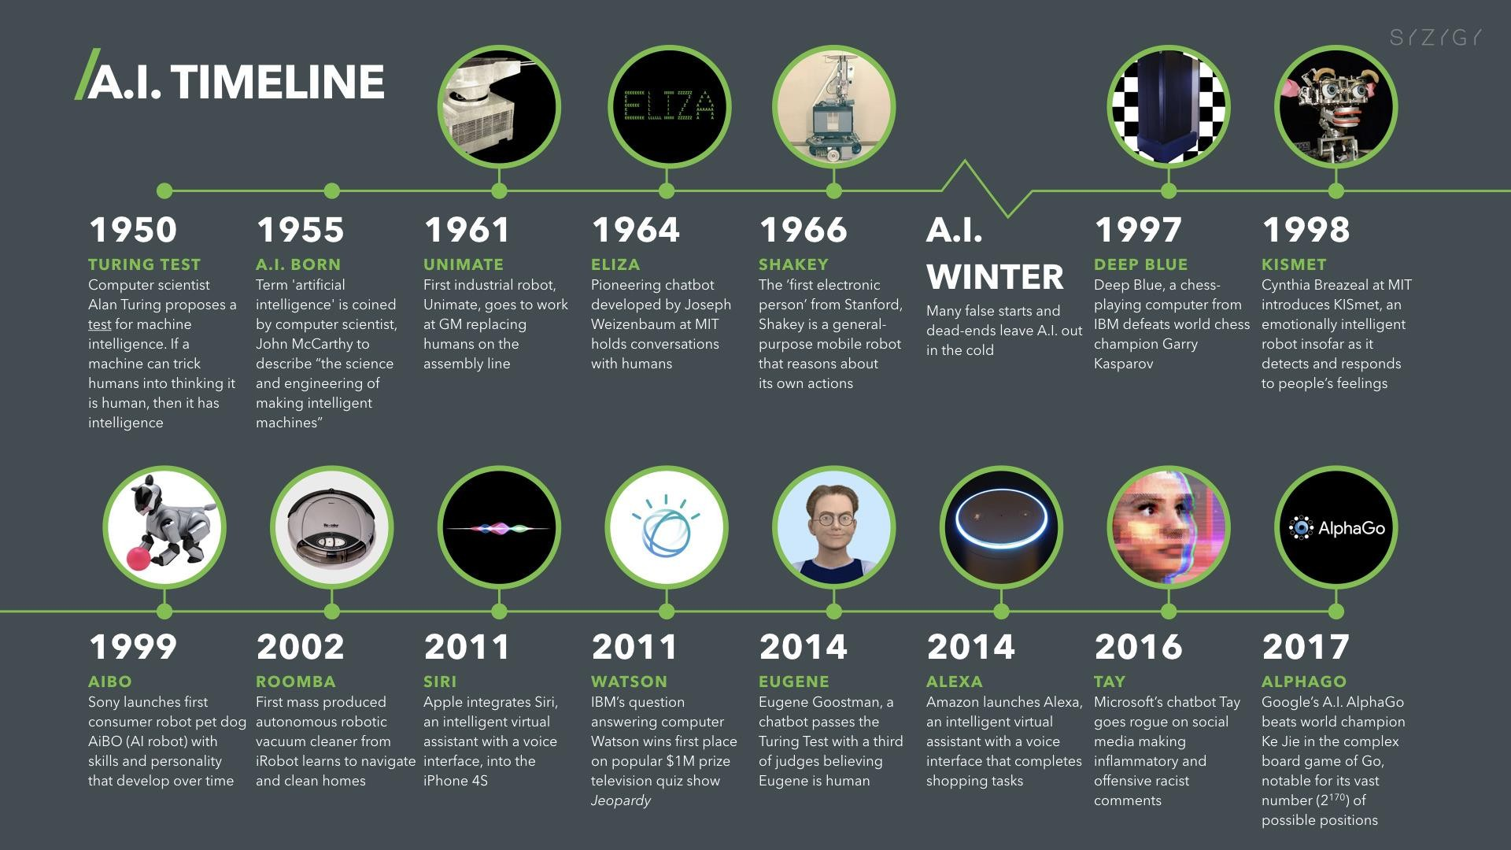

Slide 13
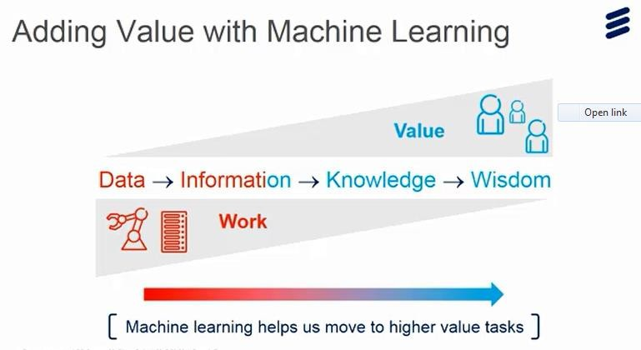

Slide 14
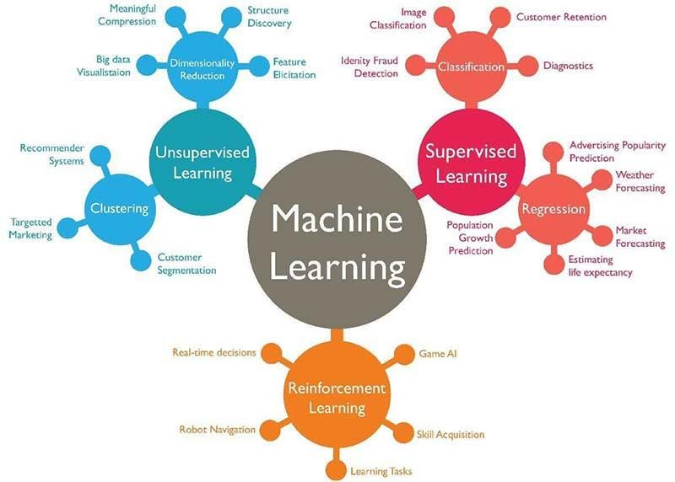
Source: https://www.techleer.com/articles/203-machine-learning-algorithm-backbone-of-emerging-technologies/

Slide 15
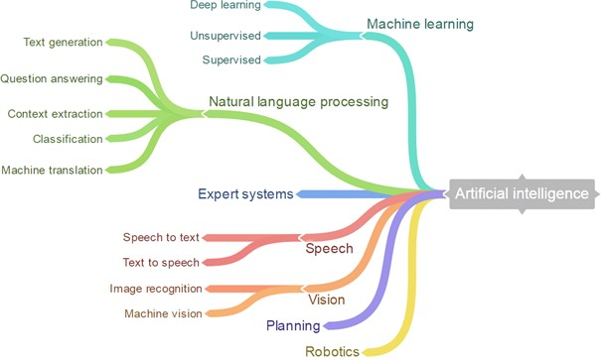

Slide 16
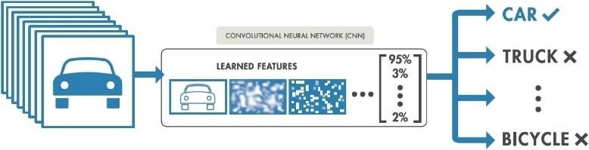

Slide 17
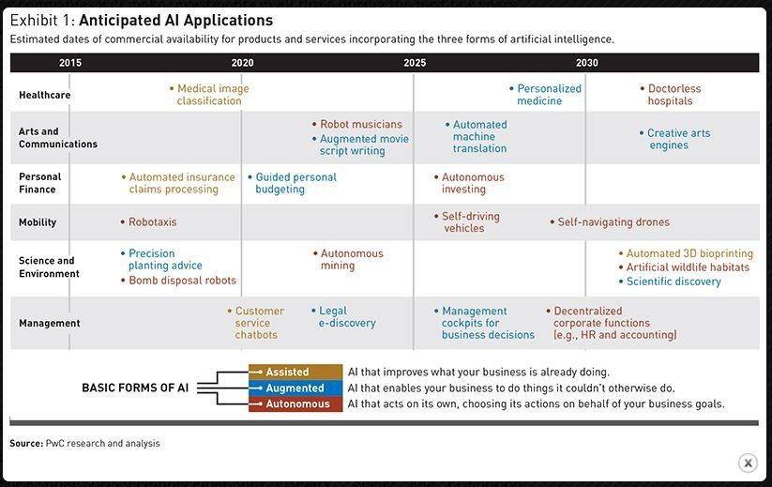
Source: A strategist guide to artificial intelligence

Slide 18
HOW

Slide 19
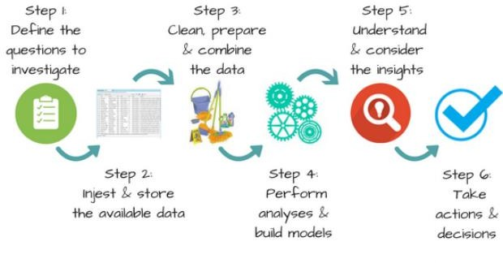
Source: Selis

Slide 20
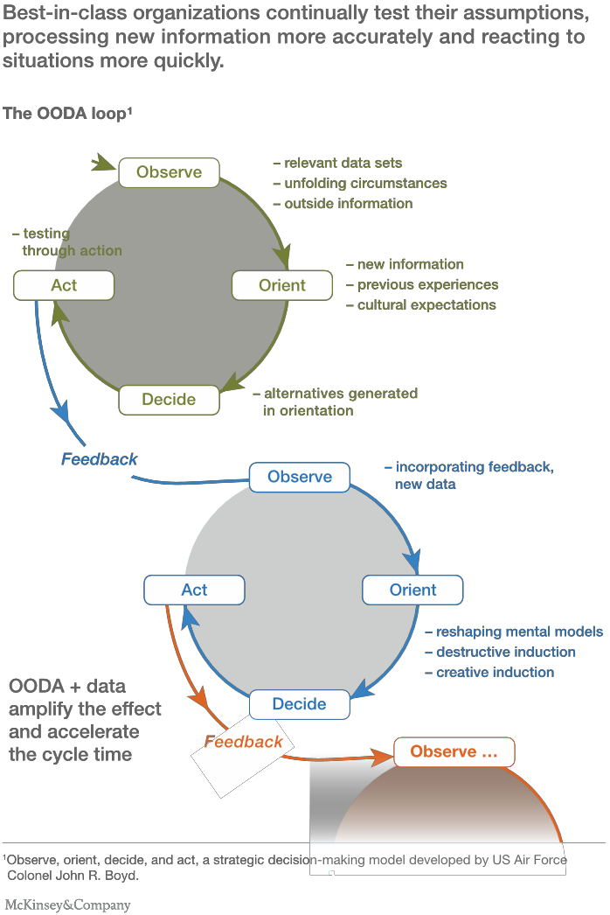
Make data analytics work for you, not the other way around (McK)
Purpose-driven DATA
Ask the right questions Think small, … and very big Embrace taboos
Connect the dots
From outputs to ACTION
Run loops, not lines
Make output usable and beautiful
Build a multiskilled team
Make adoption your deliverable
Source

Slide 21
Analytics Best Practices
Key Success factors for Advanced analytical capabilities
People
Intent
Data
Tools
Source: Bain

Slide 22

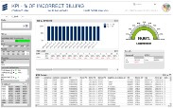

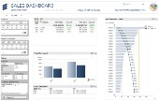
OPERATIONAL ANALYTICS
SOLUTION OVERVIEW
The solution is to build One Operational Analytic Reporting Framework based on Enterprise
Platform Architecture to Leverage Global Analytic Capabilities and Investments.
Inputs Data Warehouse Dashboard
› SAP data
› Global Resource
› CRM
› Delivery Tool
› Billing & Invoices
› Customer Portals
› POs
HANA / LEDW
Global & Local Data Sources
Data Storage & Processing
Data Visualization &
Reporting

Slide 23
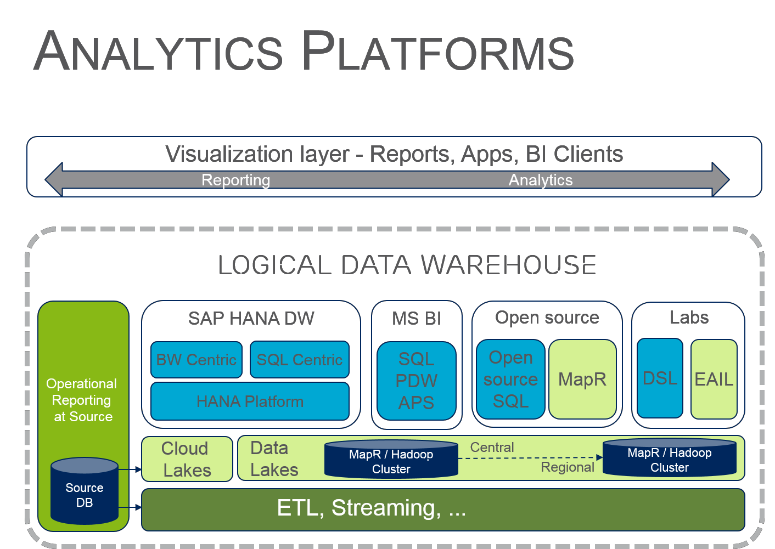

Slide 24

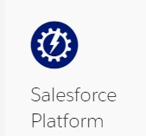






PaaS
AI
Big Data
ANALYTICS
Mobile
IoT
Platform as a Service
Network AD
DDBB
Key Mgmt
COMPUTING
STORAGE
SECURITY
NETWORKING
DATA CENTER:
RESOURCES, LOCATION, CONNECTIVITY, ENERGY..
Source: https://www.itcentralstation.com/categories/paas-clouds
Source: https://www.g2crowd.com/categories/cloud-platform-as-a-service-paas
Source: http://www.cbronline.com/news/mobility/security/10-of-the-best-paas-providers-4545381/

Slide 25
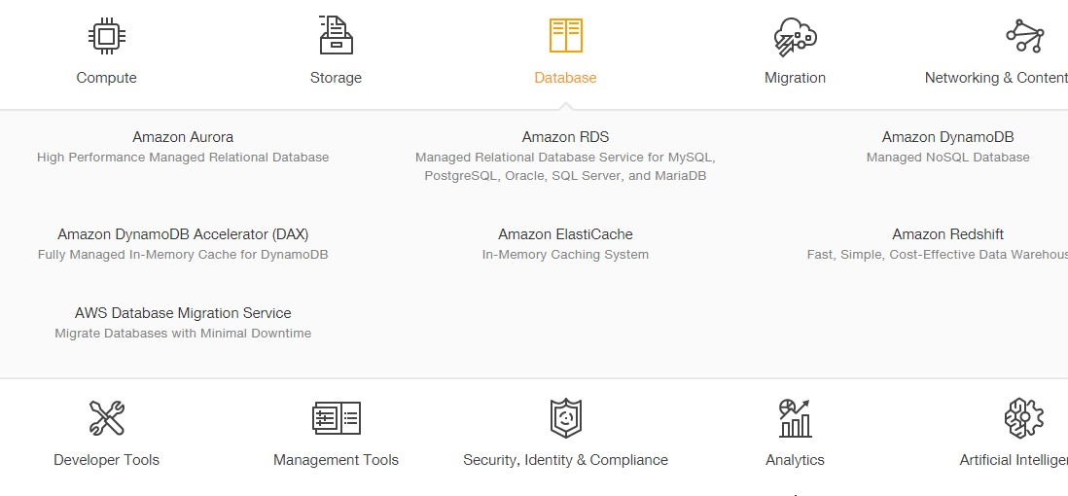
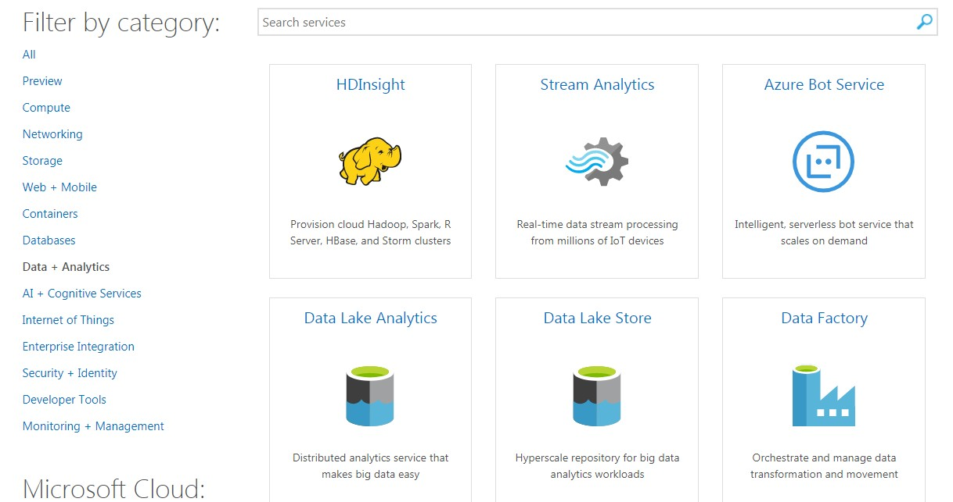
PaaS
AI
Big Data
ANALYTICS
Platform as a Service
DB

Slide 26
Python
Why Python
Ease of integration with c c++ and FORTRAN code .Ease of integration with legacy code
Suitable for both research and production system. Lnaguages like R and SAS are good for research but later on have to be ported to Java C# C etc for production
Python Basics
Indentation ,not braces .
: start of indented code
; to separate multiple statements
Everything is an object
Number
OBJECT : associated with type& internal data
Class
String
Model
Data Structure

Slide 27
Python
Text preceded by # is i ignored by Python interpreter
Functions are called using parentheses and passing zero or more values
ex result = f(x,y,z)
g()
Variable and argument passing : When assigning a variable you are creating reference to object on right hand side
ex :a=[1,2,3]
b=a
print ‘b’
b will reference to value of a and print but it will not copy values of a as in Java and C++ . Advantage :?
Type information like int ,string is stored in object itself .Object reference s does not have type associated with them like in Java ,C++.Variables are names for object within particular namespace ,the type information is stored in object itself.
Files are imported with .py extension
Binary operators are same as in other languages .Only difference is in Python you can script it like writing ex if a=6 ; b=10 you can simply write a+b for addition
Object Types
Mutable
Immutable
Can be modified
Cannot be modified

Slide 28
Python
Scalar type are small set of built in types for handling numerical data ,strings ,Boolean values and date and time
None – Null , Str :String etc.
Loops if ,elif and else ,for loops,while loops can be exited with break password
Tupple
Fixed length immutable sequence
Any sequence can be converted to tuppl eby invoking tupple
If object inside tupple is mutable you can modify it in place
Multiplying Tupple by an integer will result in that many copies of tupple
If you try to assign to tupple like expression of variables ,python will attempt to unpact the values on RHS of equal sign
Count gives number of elements in tupple
List
Variable length ,mutable
Append to add element
Insert to insert element
Remove/pop for removing element
Sort for sorting list
bisect.insert is for inserting element to the location
Dict :Hash map or associative array .Flexibly sized collection of key value pass were key and value are python objects . D=[‘a’:’some value’ ; ‘b’:[1,2,3]}
Delete is by del/pop
Update – d.update
Keys are immutable (hashability )

Slide 29
Python
Scalar type are small set of built in types for handling numerical data ,strings ,Boolean values and date and time
None – Null , Str :String etc.
Loops if ,elif and else ,for loops,while loops can be exited with break password
Tupple
Fixed length immutable sequence
Any sequence can be converted to tuppl eby invoking tupple
If object inside tupple is mutable you can modify it in place
Multiplying Tupple by an integer will result in that many copies of tupple
If you try to assign to tupple like expression of variables ,python will attempt to unpact the values on RHS of equal sign
Count gives number of elements in tupple
List
Variable length ,mutable
Append to add element
Insert to insert element
Remove/pop for removing element
Sort for sorting list
bisect.insert is for inserting element to the location
Dict :Hash map or associative array .Flexibly sized collection of key value pass were key and value are python objects . D=[‘a’:’some value’ ; ‘b’:[1,2,3]}
Delete is by del/pop
Update – d.update
Keys are immutable (hashability )

